Slide 1
How to create Derby Database in eclipse
By Sandesh VAKALE
MSc SE EPITA INTERNATIONAL

Slide 2
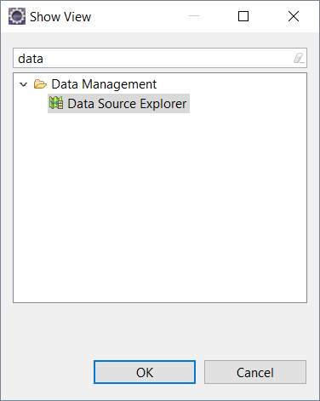
Download latest version of derby from below link:
https://db.apache.org/derby/derby_downloads.html
Copy derbyclient.jar file from lib folder of derby and paste it in your existing project lib folder. This will ensure smooth execution of your code in another system and there will be no need to make changes in your .classpath file.
Open eclipse and follow this command
Window-> Show view -> Other… -> Data Management -> Data Source explorer

Slide 3
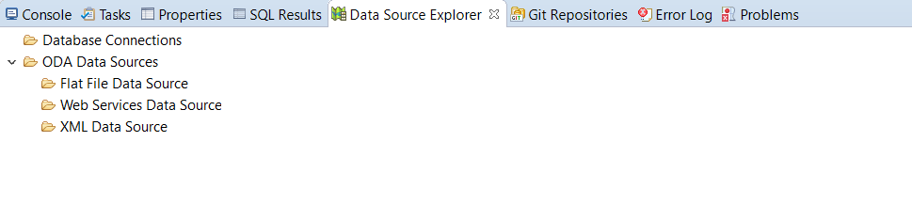
Now in database explorer tab, right click on Database connection and then click on New..

Slide 4
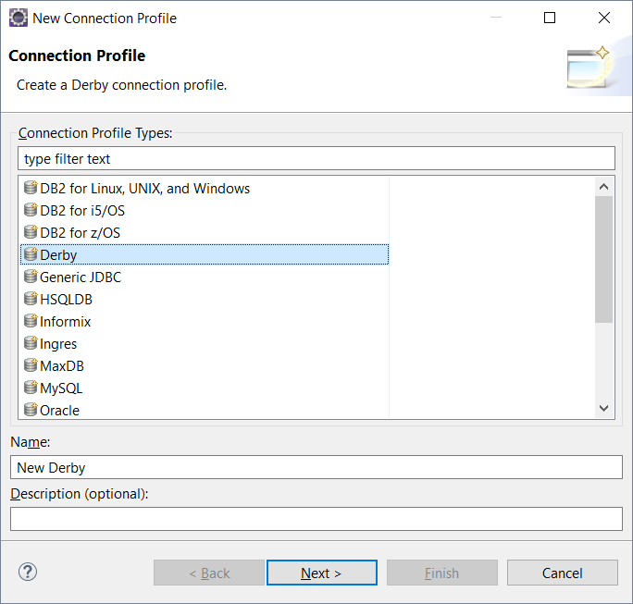
Click on Derby
Use preferred name
Click on next

Slide 5
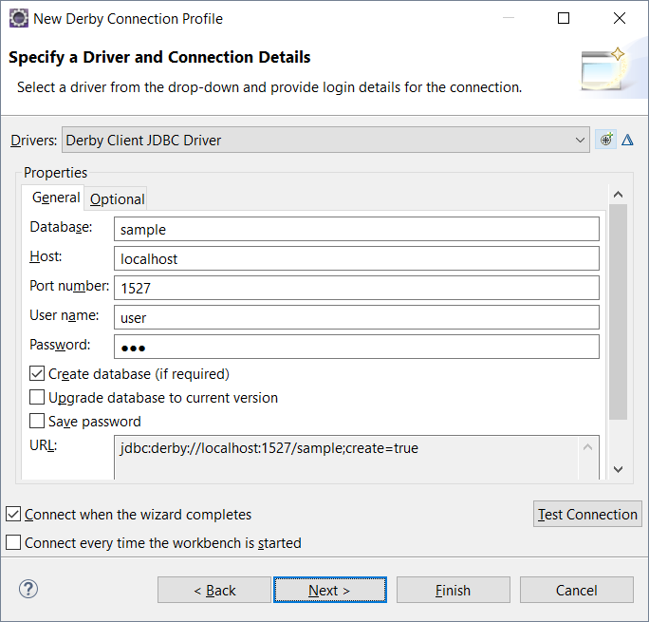
Provide preferred Database Name, User Name and Password
Click on this Option

Slide 6
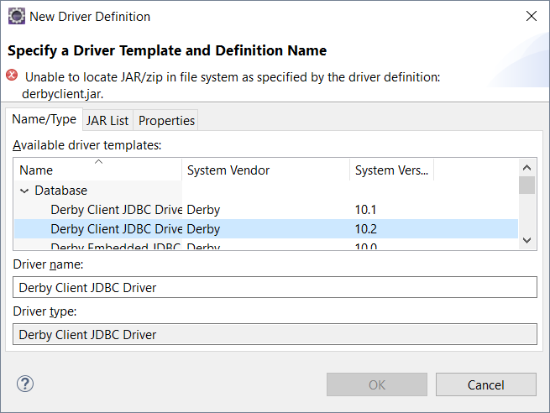
Select latest derby level and then click on JAR List Tab

Slide 7
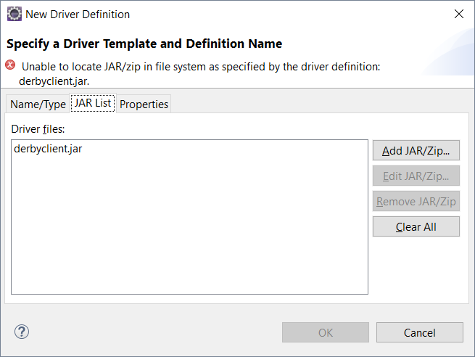
Click on Add JAR/Zip .. Option and select derbyclient.jar from your existing project lib folder.
Remove older derbyclient.jar file and then click on ok.
Without closing connection profile tab in ecplise, Open bin folder in file explorer from derby download folder and double click on startNetworkServer.bat file

Slide 8
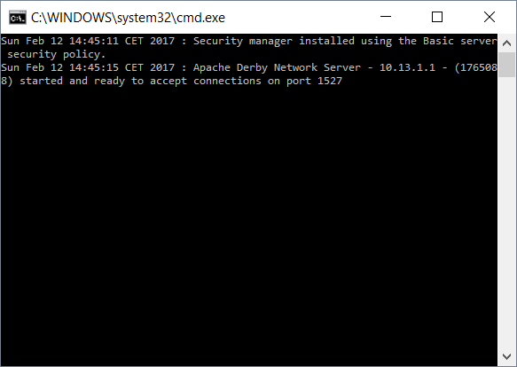
Below window will appear when you will start network. Do not close it until you are working with database.

Slide 9
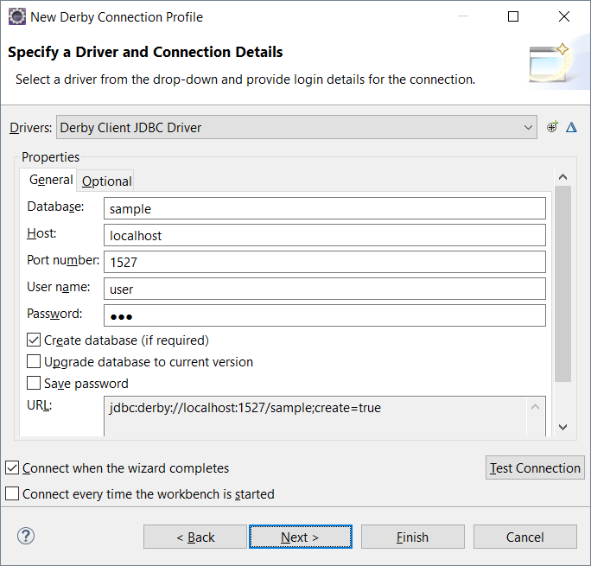
Now in eclipse, in derby
connection profile, click
on Test connection

Slide 10
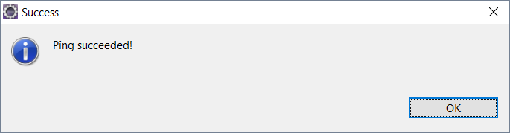
If you are getting below message then your connection is done.
Click on OK and then click on Finish.
You can also update your jar file in .classpath file by bellow procedure.
Right click on your project->build path->configure build path

Slide 11
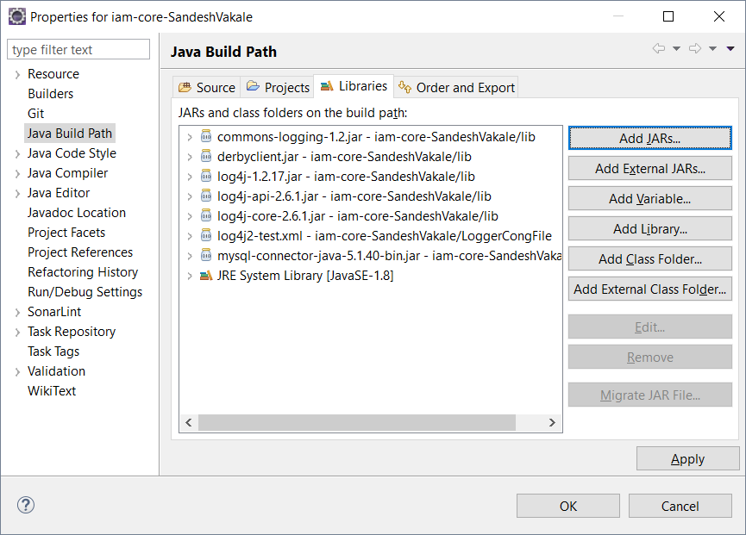
If your derbyclient.jar file is not available here then click on Add JARs.. And open your lib folder of existing project. Select derbyclient.jar and then click on Apply.

Slide 12
Thank you
By Sandesh VAKALE
MSc SE EPITA INTERNATIONAL

